Slide 1

The Challenges and Opportunities Of
Emergent Agrifood Systems Transformations
Christopher B. Barrett
Dyson School and Brooks School
Rose House Fellow talk
February 22, 2023

Slide 2
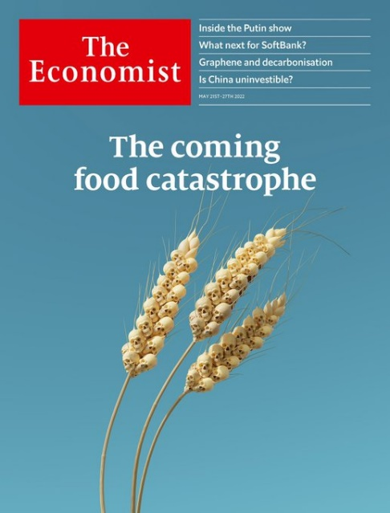
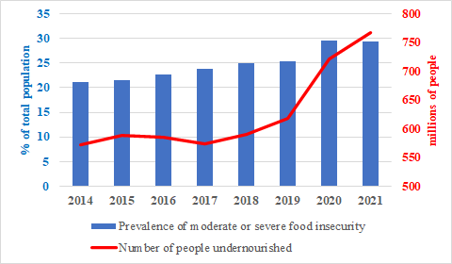
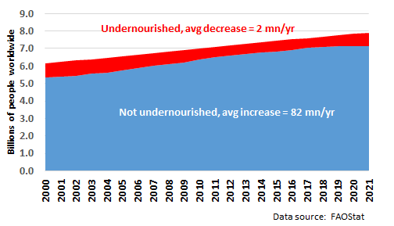
Is there a global food crisis?
“The World Is Headed for a Food Security Crisis”
– Time, Mar 2018
“A Global Food Crisis Looms” – New York Times, Apr 2020
Is there a food security crisis currently?
Yes …
… but crisis = stalled progress

Slide 3
And broader food crises
Nearly half of adults worldwide are obese/overweight.
Nearly half the global population lives in households employed in AFS, which have high rates of child/forced labor and one of the three most hazardous employment sectors (along w/mining and construction).
AFSs account for a large share of new infectious disease (≥50% of zoonoses).
AFSs contribute 20-30% to GHG emissions, helping cause, rather than resolve, the climate crisis.
Largest driver of deforestation, habitat and biodiversity loss, major cause of water pollution, hypoxia and hazardous algal blooms.
AFSs urgently need transformation to address multiple crises.

Slide 4
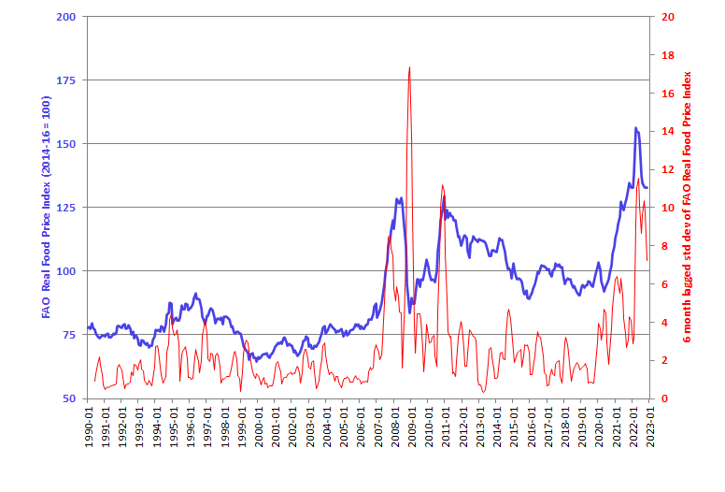
Why stalled progress and crises?
Demand growth has outpaced supply growth since roughly 2000. This brought higher – and more volatile – commodity prices.

Slide 5
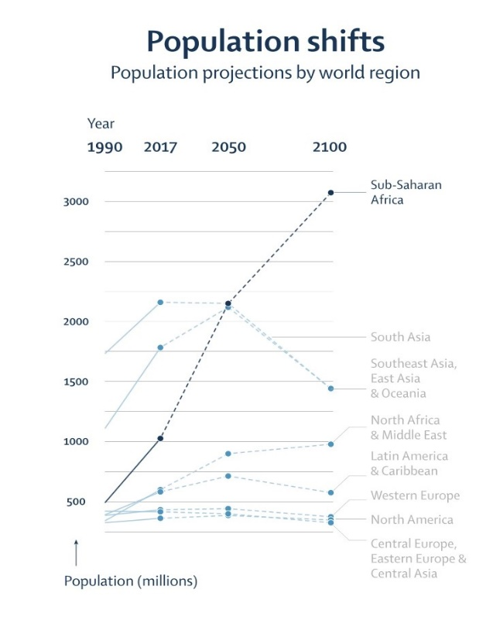
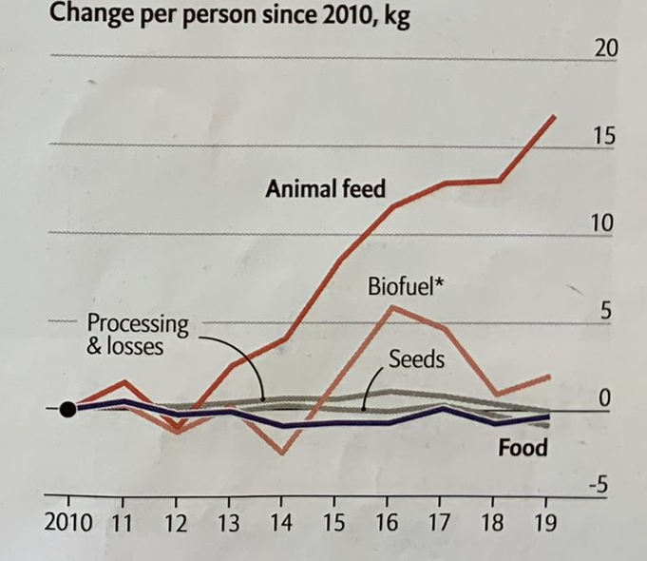
Why stalled progress?
Main long-run drivers:
1. Robust food demand growth, almost entirely in Asia and Africa
Due mainly to population/income growth
(and urbanization).
Policies don’t slow/shift demand much.
Vollset et al. Lancet 2020
Source: The Economist June 25, 2022

Slide 6
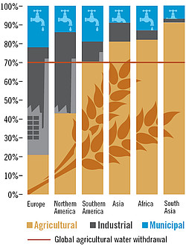
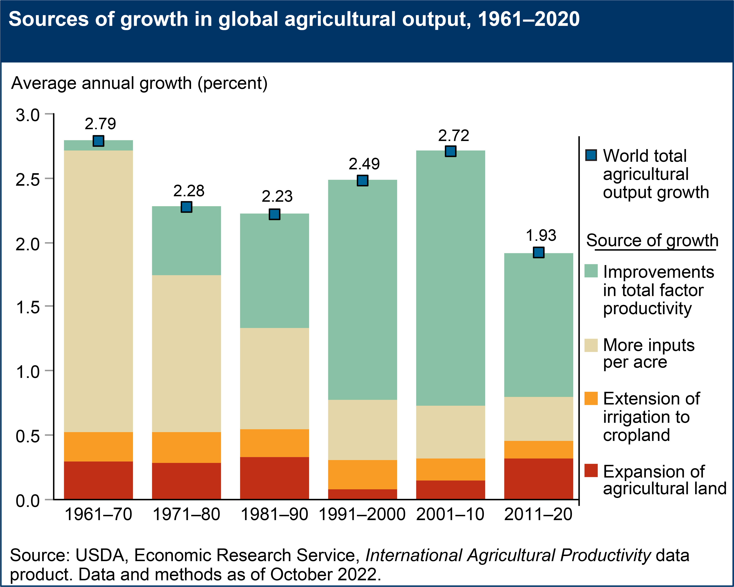
Why stalled progress?
2. Increasingly strong headwinds for supply growth
Land/water constraints + climate change + slowing productivity growth
Source: https://www.globalagriculture.org/report-topics/water.html
Less of a challenge for NY than elsewhere ☺

Slide 7
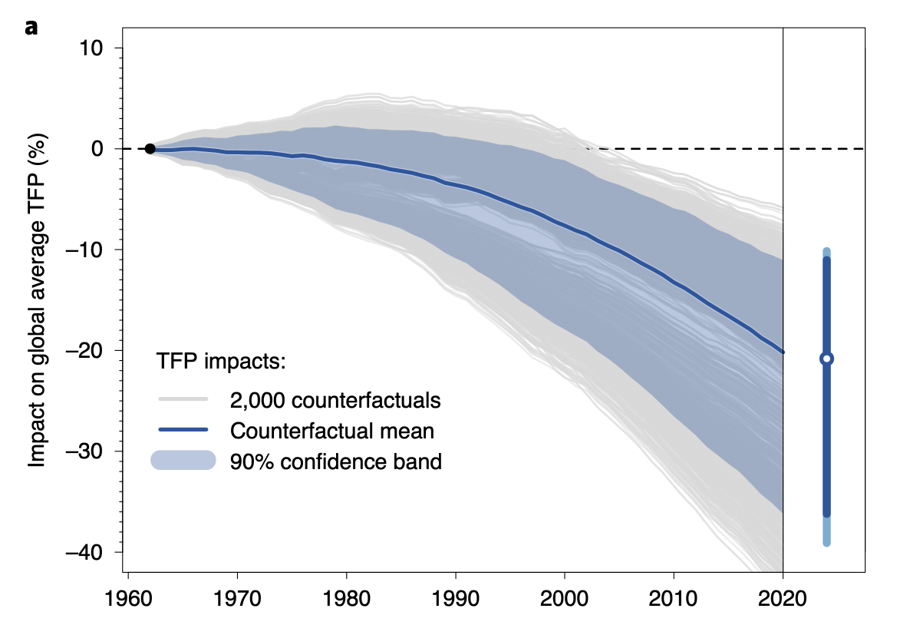
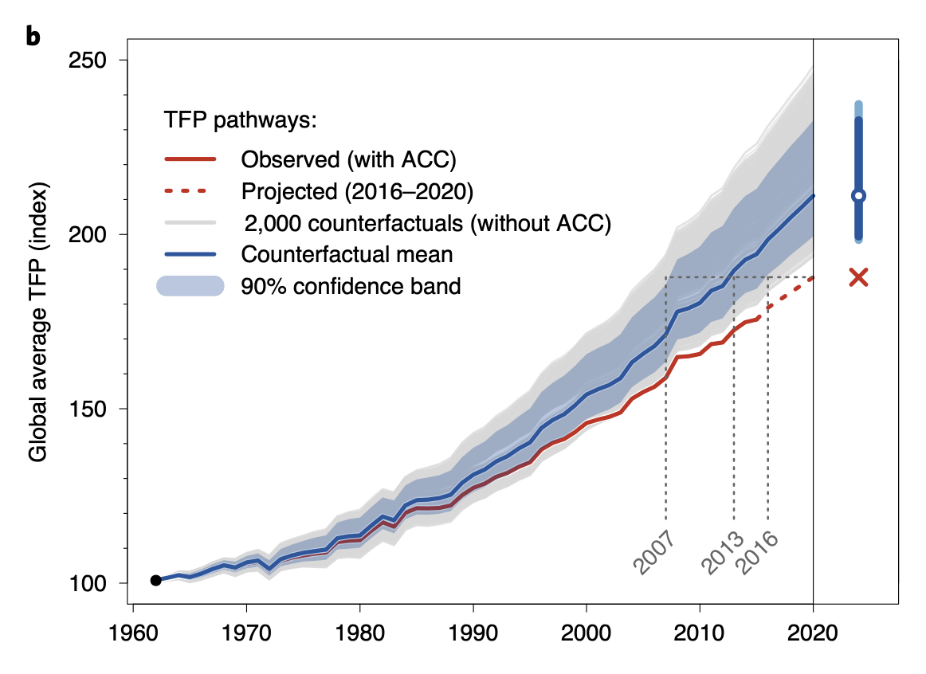
Why stalled progress?
Insufficient investment in sustainably boosting agrifood productivity leaves the world vulnerable to ‘perfect storms’, which occur more often.
1. Climate change:
Fuel demand growth by forced displacement – climate refugees, droughts, etc.
Mainly it retards productivity advances and investment
Source: Ortiz-Bobea et al (Nature Climate Change, 2021)

Slide 8

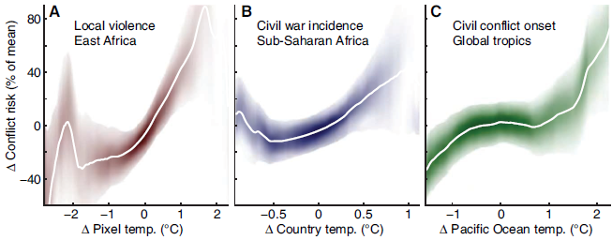
Why stalled progress?
2. Conflict:
>89mn forcibly displaced +~15mn Ukraine this year… highest on record
Conflict-affected nations >75% of stunted children globally (FAO et al. 2017)
Pop. in fragile settings growing. >2bn now, ~ 80% world’s poor (OECD 2018)
Food insecurity destabilizes societies lacking strong social
safety nets. Unrest in ~50 nations 2007-12. Sri Lanka now.
And climate change makes it worse …
(Hsiang et al. 2013)

Slide 9
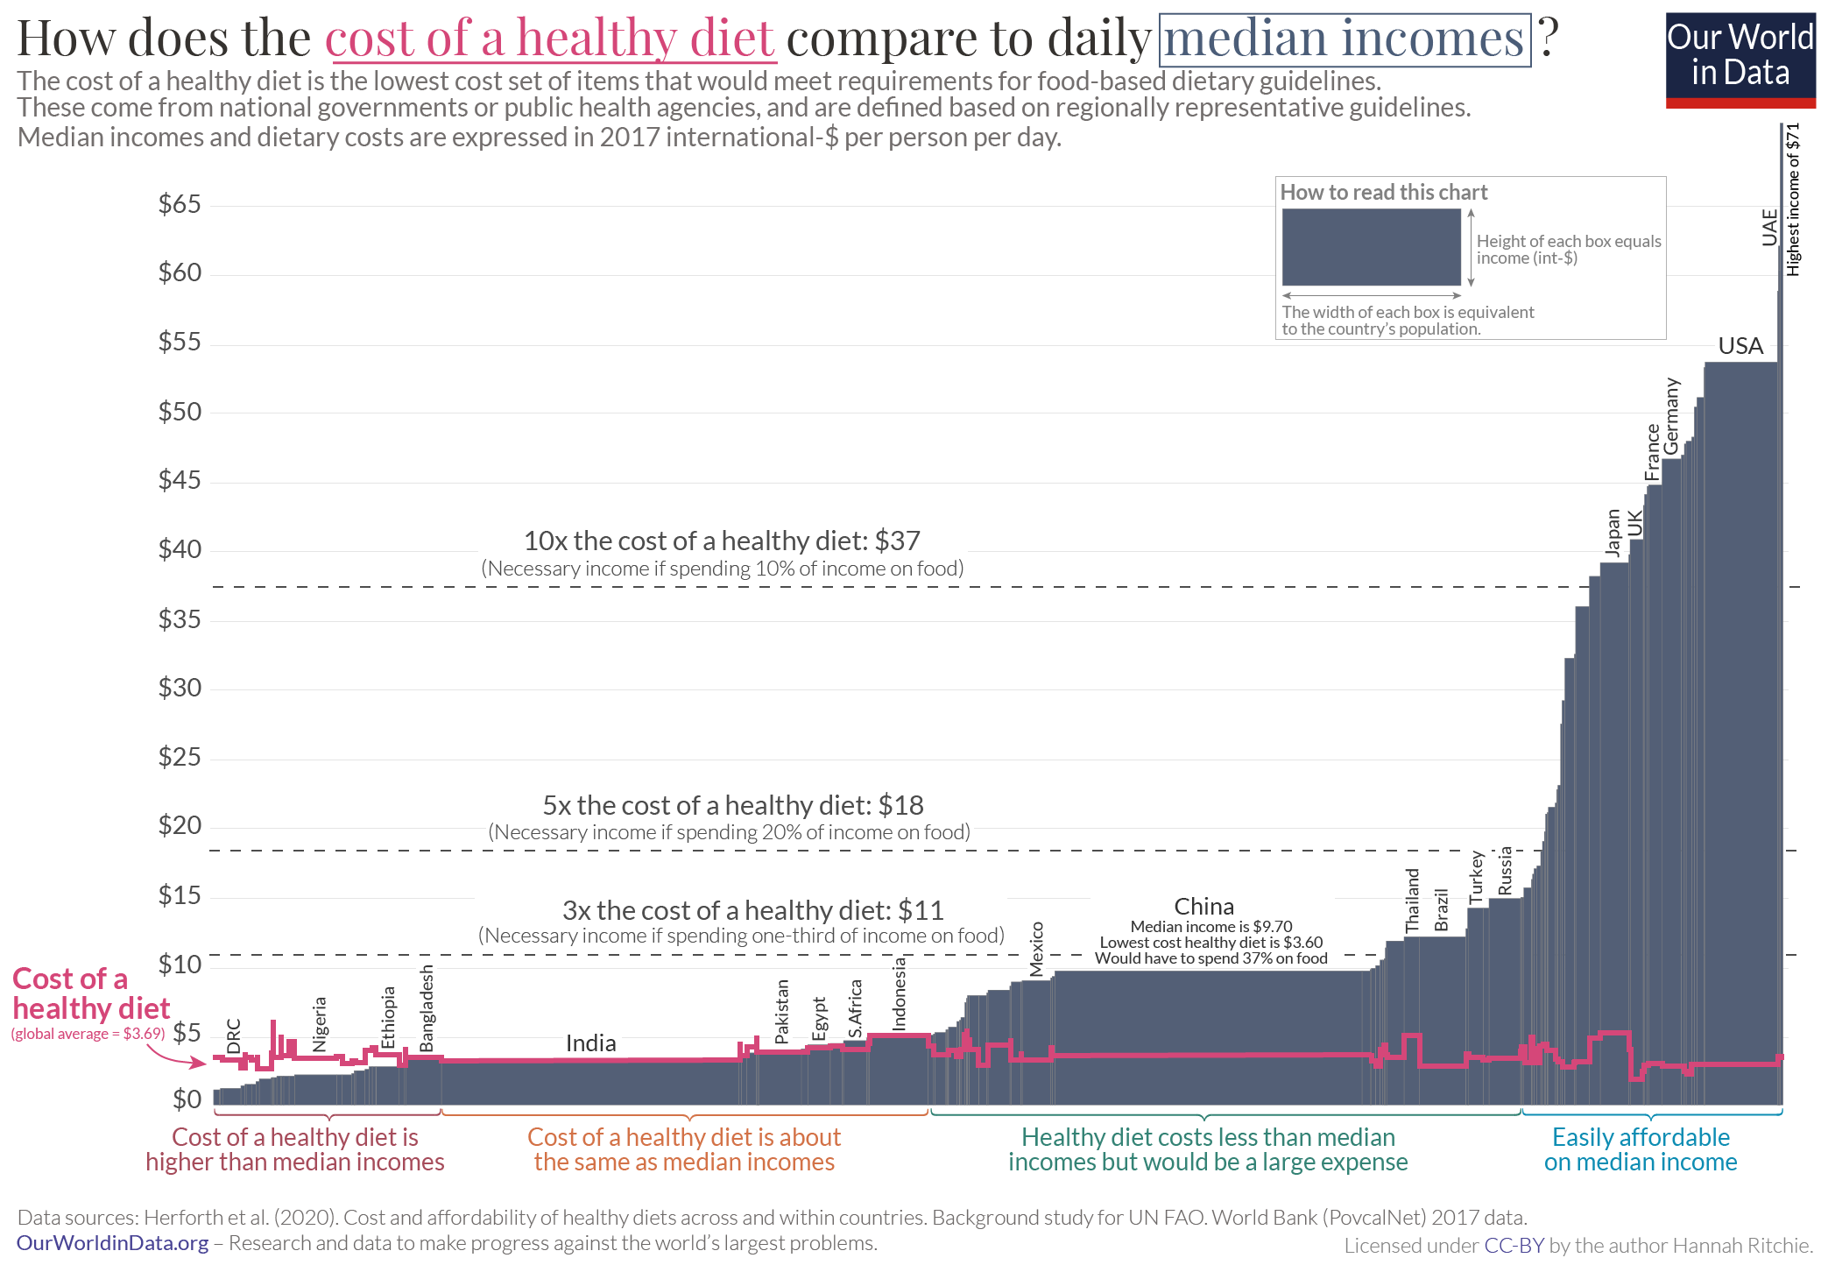
Why stalled progress?
3. Macroeconomic growth and stability
Poverty is main cause of food insecurity. COVID slowed growth; poverty rose. Macro instability fuels flight to dollar, debt/food prices worsen in LMICs. >3 bn cannot afford a healthy diet. Safety nets are currently insufficient.

Slide 10
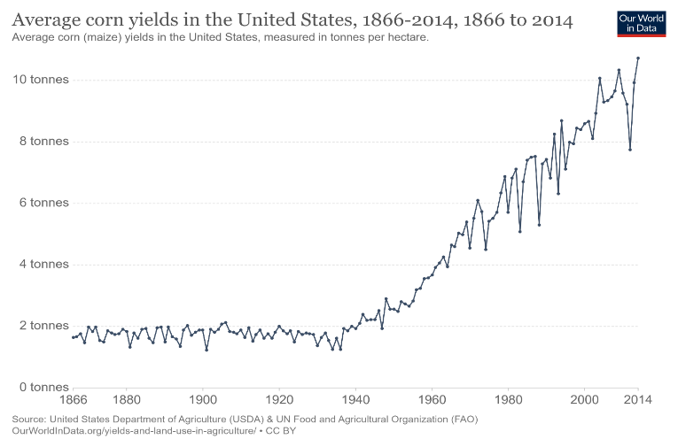
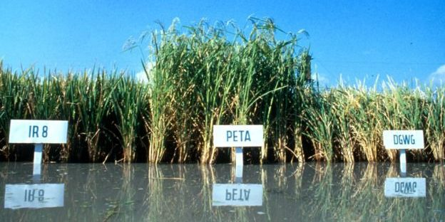

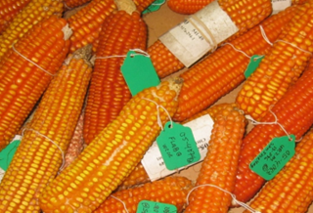
Don’t despair … innovate!
The world has previously and can again overcome global food crises. Higher prices induce AFS innovation. Do well by doing good!
Photo credits: IRRI, Edesia, Mike Gore
We can prevail again IFF we again follow a progressive strategy:
Trust and invest in science + solidarity w/poor.

Slide 11
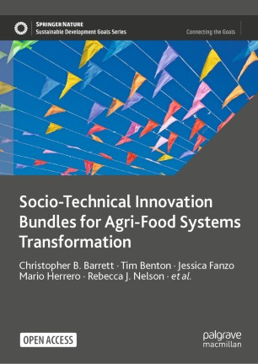
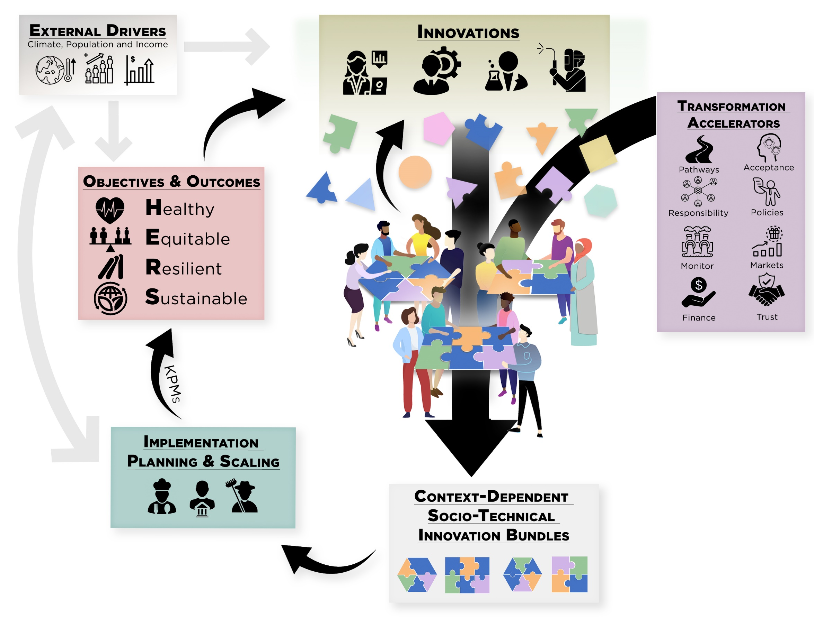
Innovation objectives are shifting
The objectives of 21st century agrifood system innovation have shifted.
Profit-seeking less by boosting yields than relieving land/water/ chemical constraints and not from growing more calories but rather by meeting rising consumer demand for non-caloric attributes.
Like
Solutions are never just technical. Like prior successful AFS transformations, must bundle both technological and socio-economic innovations.

Slide 12
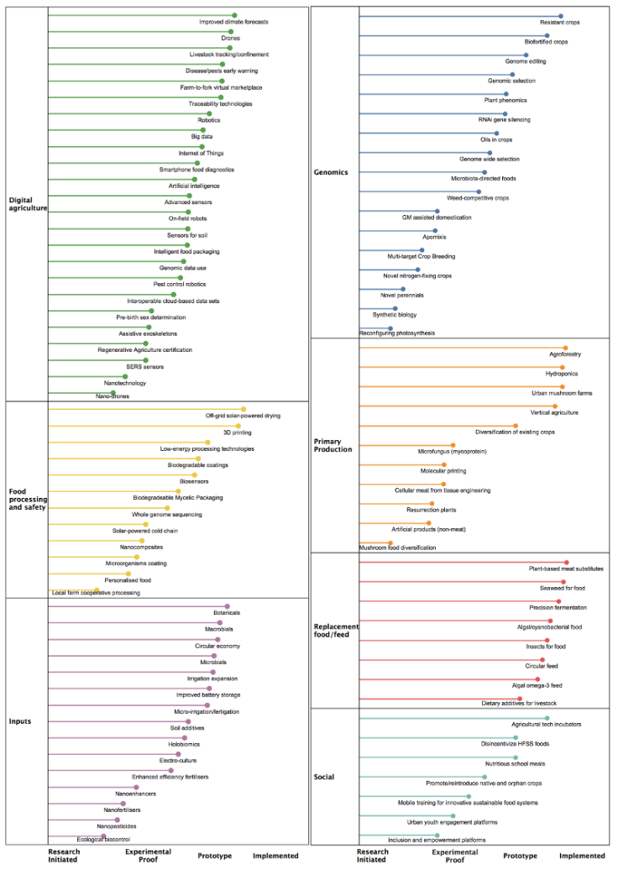
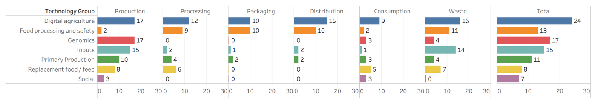
Ample STI in pipeline
Many promising pre-emergent/emergent science, technology and innovations (STI) advances of variable deployment readiness.
Spans value chains and geographies.
Reflects massive investment … $52bn in 2021 agrifood tech VC investment … up 85% over 2020, 134% on 2019 and ~600% vs. 2016!
Massive change is coming. Engage!

Slide 13
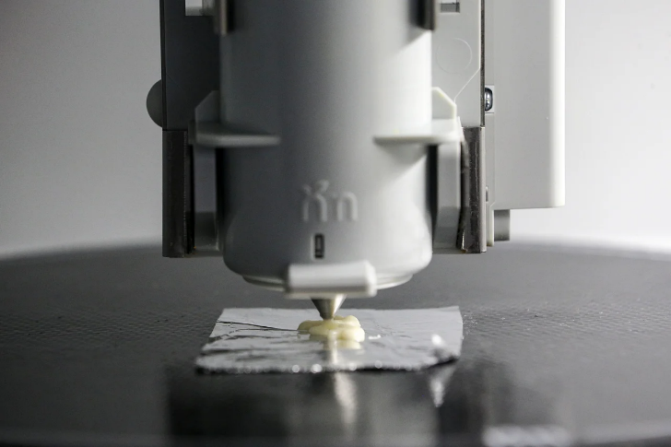
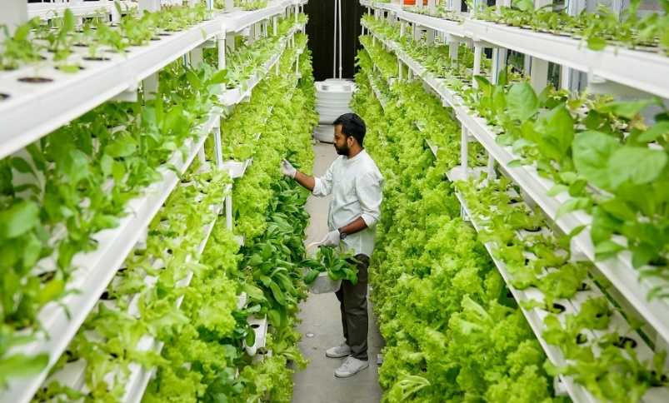
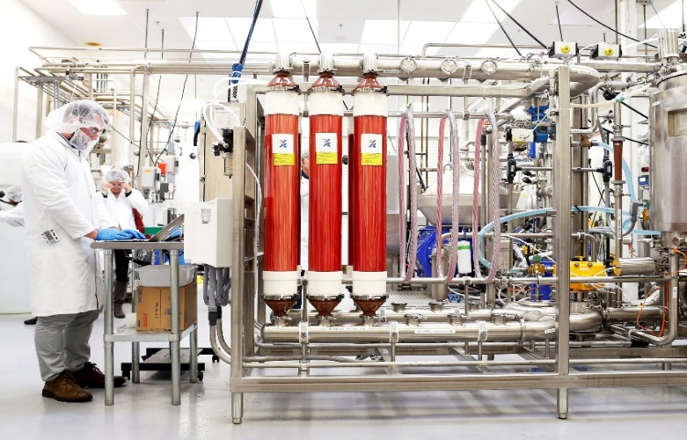
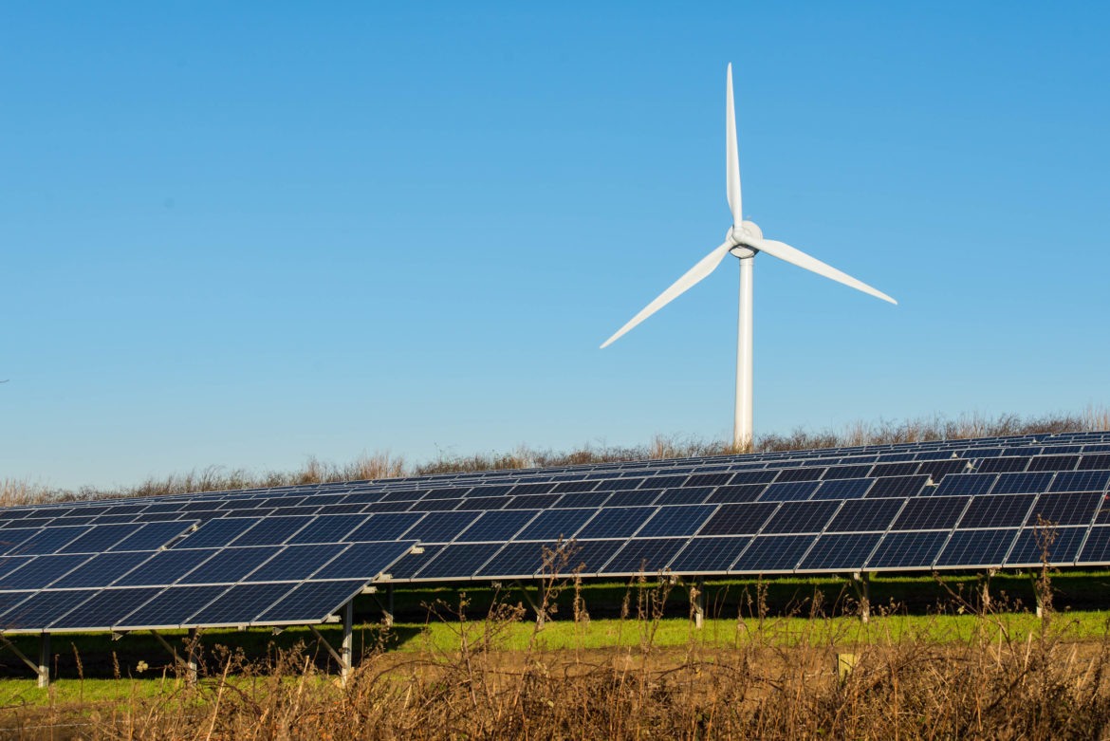
De-agrarianization
Decoupling food production from land is increasingly culturally, economically, technologically feasible. Crucial for climate and infectious disease control.
Photo: Wallace Woon (Straits Times)
Photo: Betterindia.com
Photo: Beck Deifenbach/Reuters
Inevitable. Learn the lesson of rennet.
Must manage de-agrarianization’s creative destruction
proactively. Build rural livelihood opportunities: farm carbon, solar, wind and wildlife; CEA in idle, low-cost structures.
Photo: Gerry Machen/Creative Commons

Slide 14
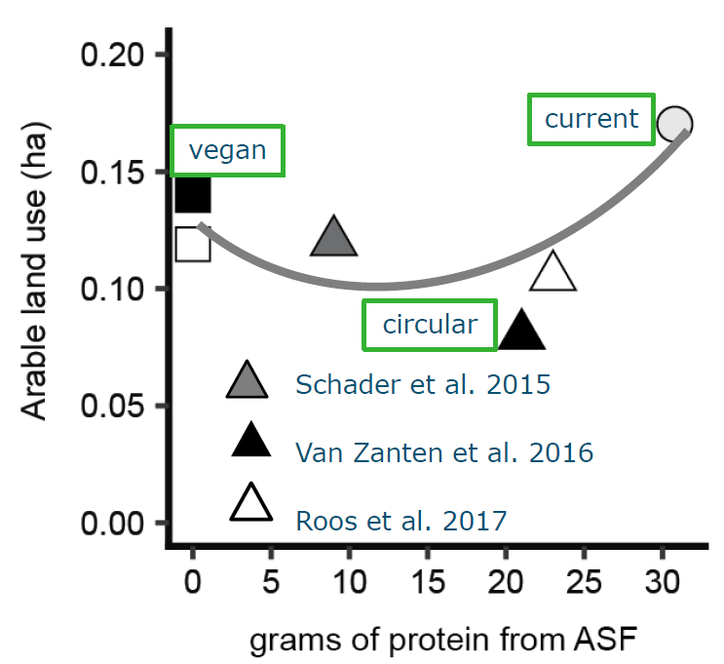
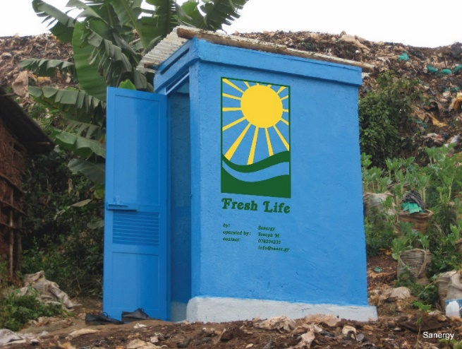
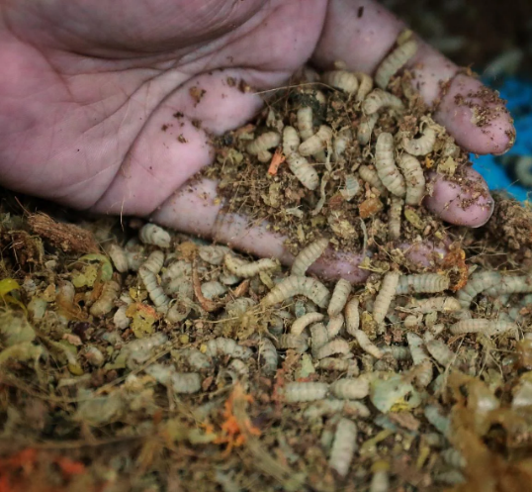
Circularity
Need cheap food for the poor. But cheap food inevitably induces loss and waste.
Recapture the nutrients as feed and fertilizer to help de-agrarianize!
Credits: Sanergy; Andrew Simons et al.; Jason Quah, Straits Times; H. Van Zanten
Can maintain 2/3 animal-source foods consumption w/o food-feed competition.
Reduce cost and geopolitical/mkt vulnerability to NPK supply disruption.

Slide 15
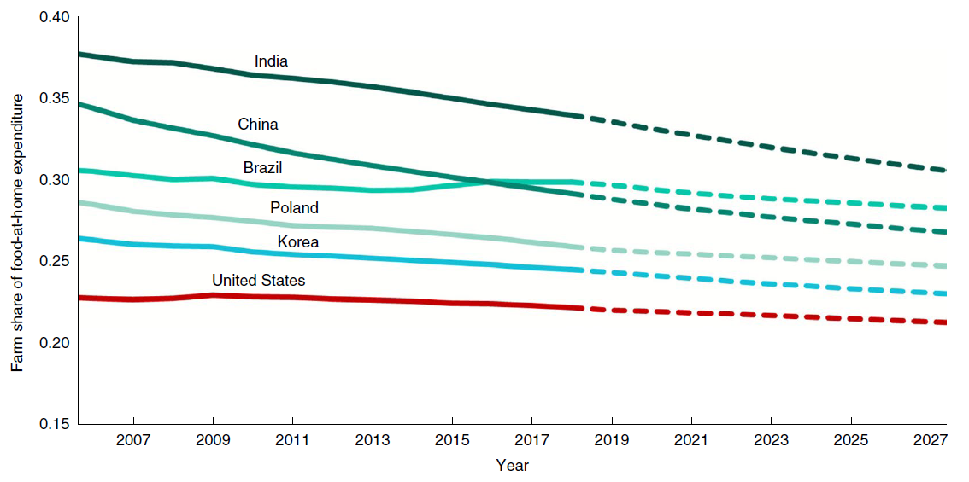
Downstream changes
Most AFS jobs and value creation (~3/4 globally!) occur post-farmgate and that share grows with incomes and ag TFP growth.
Consumers and downstream firms increasingly drive AFS change!
Source: Barrett et al., J. Econ.Lit. 2022
Source: Yi et al., Nature Food 2021

Slide 16
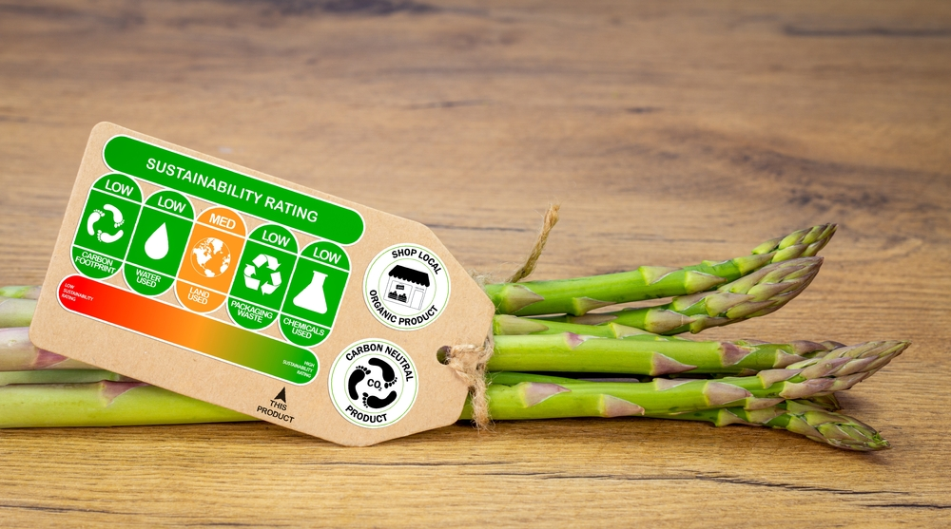
Downstream opportunities
Consumer demand for non-nutritive food attributes will increasingly drive upstream production patterns.
Better off consumers are less price sensitive.
Shifting procurement contracting terms.
Trustworthy labeling backed by traceability.
Source: https://www.nycfoodpolicy.org/food-policy-snapshot-denmark-climate-label/

Slide 17
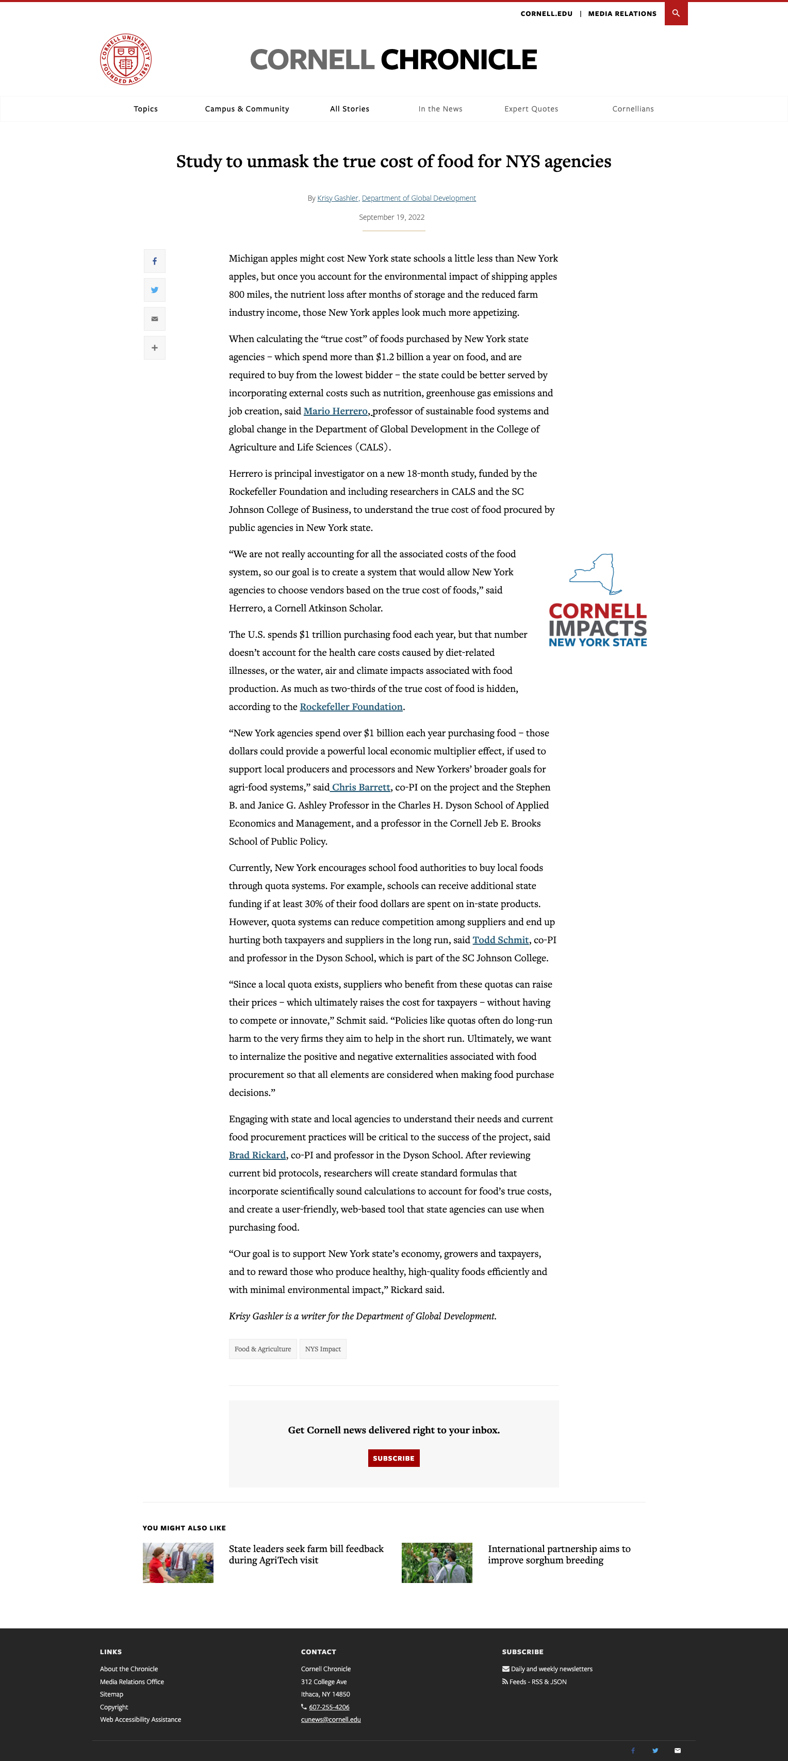
True cost pricing
in public procurement
THE TRUE COST OF FOOD PROJECT
$1.2B
Current law requires state agencies to procure food from the lowest qualified budder.
Those prices don’t reflect important (+ and -) externalities like job creation, GHG emissions, nutrient content. This hides the true, longer-term cost of food to NY taxpayers.
And NY producers/processors disadvantaged by NY laws/regulations.
True cost pricing to induce ‘race to the top’ and level the playing field for NY suppliers.
The amount New York state agencies spend each year purchasing food.
03
cals.cornell.edu/food-systems-global-change/true-cost-food

Slide 18
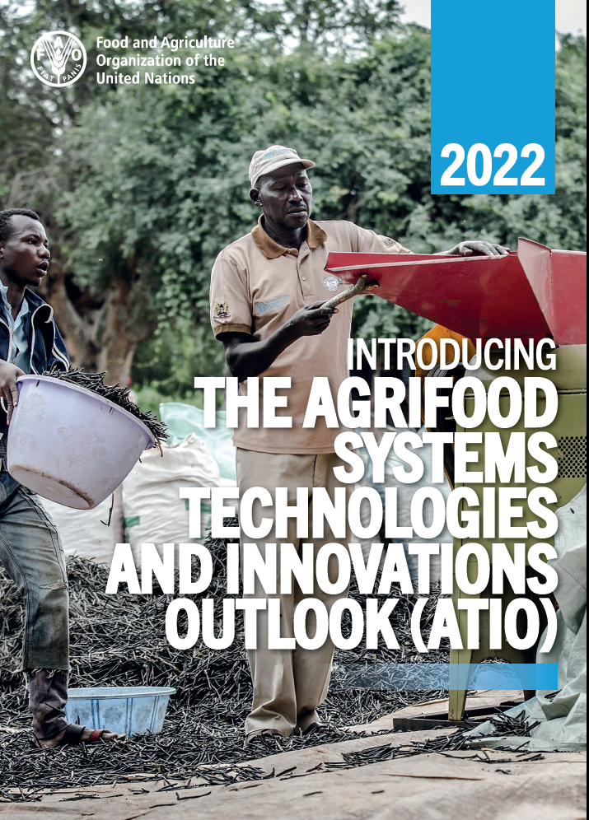
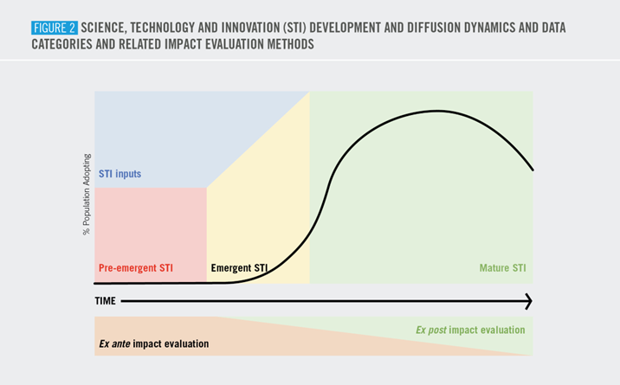
Need to level informational playing field globally
THE TRUE COST OF FOOD PROJECT
New FAO flagship report to track AFS STI life cycle, esp. for LMICs.
03
https://news.cornell.edu/stories/2022/10/cornell-co-lead-un-agencys-new-agrifood-initiative

Slide 19
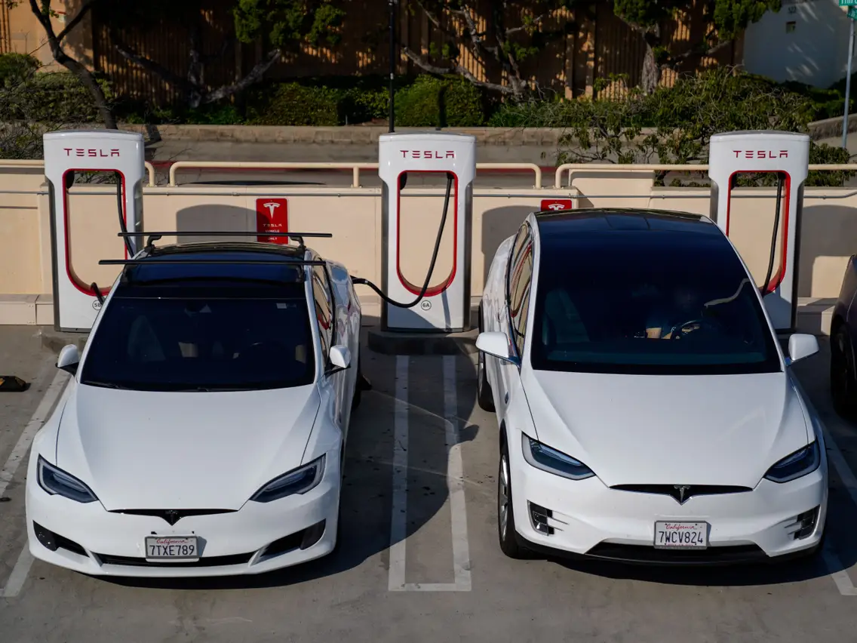

Why should we care?
Solving societal problems can be a lucrative business strategy
Human rights, sociopolitical stability, and macroeconomic growth and stability all depend on food security

Slide 20
Don’t despair, but don’t dally
The world faces a food security crisis because land, water and chemical constraints increasingly bind in face of growing demand, stalling progress. Have prevailed before in food crises and can again … will we?
Requires:
doubly progressive strategy – trust science and support the poor
focus on HERS objectives and invest in STI, incl. circularity,
de-agrarianization, and true cost public procurement
The only constant is change. Be prepared to adapt rural livelihoods and to seize emergent opportunities.
Thank you for your time and interest!

